Slide 1




MINI PROJECT
on
FLIGHT FARE PREDICTION SYSTEM
A MACHINE LEARNING PROJECT

Slide 2

TEAM MEMBERS
Rahul Kumar Giri
Priyansh Kisan
Ayush Tayal
2201330120093
2201330120088
2201330120036

Slide 3
OBJECTIVE
Develop a predictive model for accurately forecasting flight fares.
Empower travelers with real-time fare predictions and insights.
Enhance the transparency and confidence of travelers in booking flights.
Optimize pricing strategies for airlines and other stakeholders in the airline industry.
Maximize savings for travelers and improve revenue generation for airlines.

Slide 4

INTRODUCTION
Fluctuating flight fares pose uncertainties for travelers, making trip planning and budgeting challenging. Our project leverages data analytics and machine learning to predict flight fares accurately, enabling travelers to make informed booking decisions. Analyzing historical flight data, our predictive model identifies patterns and trends to forecast future fare fluctuations.

Slide 5
Approach
1
Data Analysis
2
Machine Learning Algorithms
Utilize historical flight data, including ticket prices, route information, travel dates, and airline specifics.
Implement advanced machine learning techniques to analyze patterns, trends, and correlations within the data.
3
Iterative Training
4
Continuous Improvement
Refine the predictive model through iterative training and validation processes to enhance accuracy and reliability.
Continuously update and optimize the model to adapt to changing market dynamics and improve predictive capabilities over time.

Slide 6




TECHNOLOGY USED
Machine Learning
Python
Web Development
Django (Framework)
Utilizing the Python programming language for data analysis and model implementation.
Leveraging advanced machine learning algorithms to develop the predictive model.
Employing HTML, CSS, and Bootstrap for the user interface and web application development.
Utilizing the Django web framework to build the application's backend and infrastructure.

Slide 7
SCOPE
The scope of this project is multifaceted, focusing on leveraging historical flight data to develop a robust predictive model for flight fare forecasting. The key objectives include:
Analyzing historical flight data to identify trends and patterns in ticket pricing.
Implementing advanced machine learning algorithms to develop a predictive model for accurate flight fare forecasting.
Providing real-time fare predictions to travelers, empowering them to make informed booking decisions.
Incorporating features such as price alerts, fare trend analysis, and optimal booking recommendations to enhance the user experience.
Concentrating on both domestic and international flights across various airlines and routes.
Considering factors that influence fare fluctuations, including demand, seasonality, and route popularity.
Collaborating with airlines, travel agencies, and online booking platforms to optimize pricing strategies and maximize benefits for all stakeholders.
By achieving these objectives, the project aims to revolutionize the way travelers plan and book their flights, while also providing valuable insights to airlines and other industry players to optimize their pricing and revenue management strategies.

Slide 8
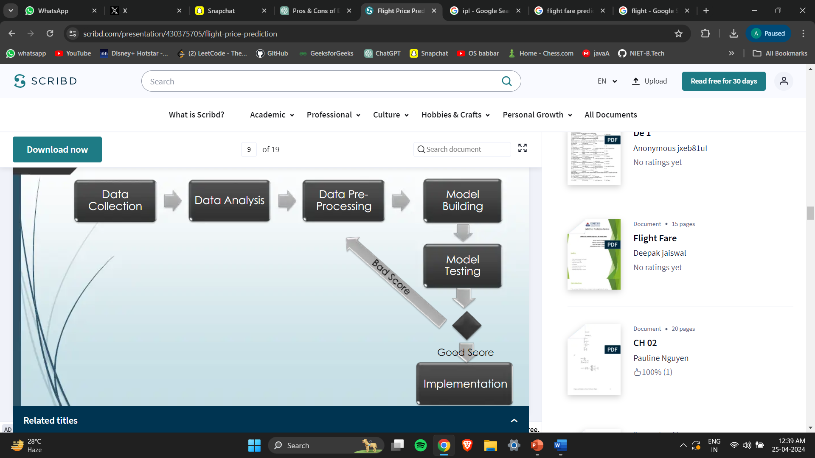

Slide 9
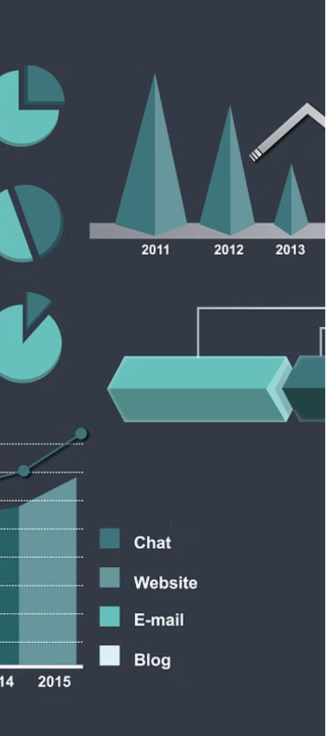
METHODOLOGY
1
Data Collection
Gather historical flight fare data from reliable sources such as airline databases, online travel agencies, and public datasets. Collect relevant features including departure and arrival destinations, travel dates, airline, booking class, and fare prices.
2
Data Preprocessing
Cleanse the collected data by handling missing values, outliers, and inconsistencies. Normalize or scale numerical features to ensure uniformity in data distribution.

Slide 10
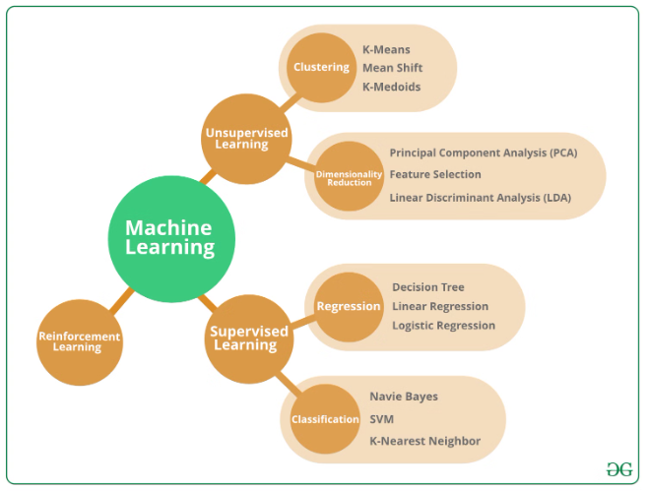
Model Selection and Training
3. Model Selection:
Experiment with various machine learning algorithms suitable for regression tasks, such as linear regression, decision trees, random forests, support vector machines (SVM), and gradient boosting algorithms.
4. Model Training and Evaluation:
Split the preprocessed data into training and testing sets for model training and evaluation. Assess the performance of the selected models using appropriate metrics such as mean squared error, R-squared, and cross-validation techniques.

Slide 11
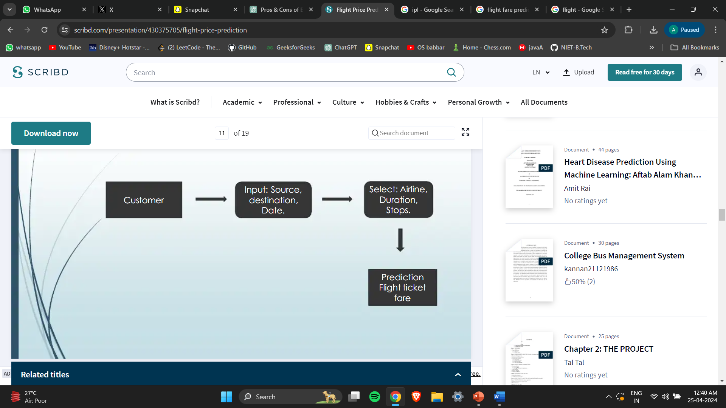

Slide 12
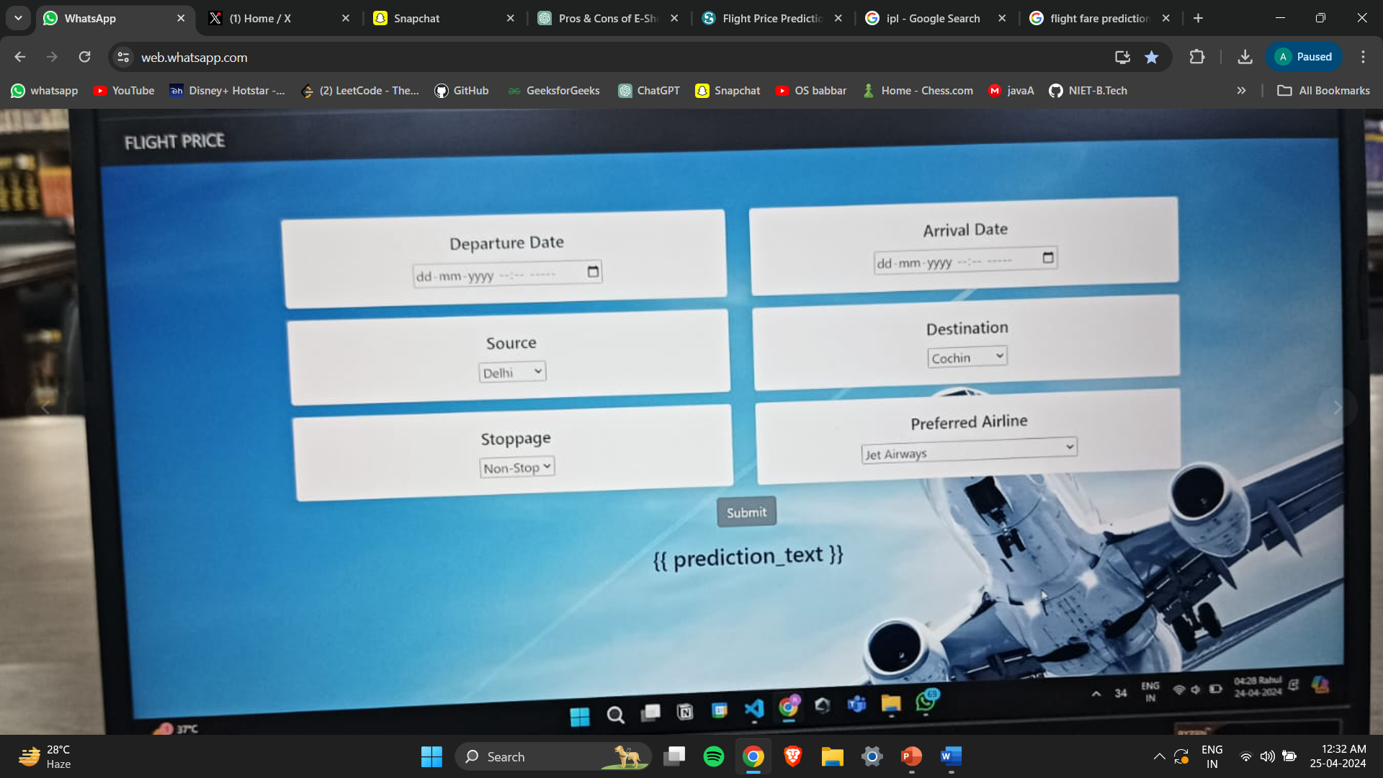

Slide 13



Model Training and Evaluation
Split Data
Split the preprocessed data into training and testing sets for model training and evaluation.
Train Models
Train the selected machine learning models using the training data, optimizing hyperparameters as needed.
Evaluate Performance
Assess the models' predictive accuracy, generalization, and robustness using the testing data. Metrics such as R-squared, mean squared error, and cross-validation scores will be used.

Slide 14


